Slide 1

User guide:
Registration to Mediaset supplier portal
Milan, July 2026

Slide 2
Introduction
XLR8 is the platform implemented by Synertrade and used by Mediaset for:
−Managing the supplier qualification process ;
−Conducting online negotiations, exploiting the potential of the integrated Supplier Portal
The Supplier Portal will allow:
To the new Suppliers who wish to collaborate with Mediaset:
  −To apply as potential bidders of goods and / or services, respecting terms and conditions defined by Mediaset (first part of this Manual).
To Suppliers who already work with Mediaset:
  −To keep updated your own personal data contained in the XLR8 systems and sending the necessary documentations for the correct managing of the different assigned furniture;
  −To submit their offer for tenders and negotiations that they have been invited to participate in;
This Manual is aimed to those Supplier who wish to collaborate with Mediaset.
In this document you will be guided, step by step, in the compilation and submission of a registration request to Mediaset Supplier’s Portal.

Slide 3
Index
1. Communication of Platform access credentials
2. First access with the credentials received by e-mail
3. Welcome page and Navigation Logic
4. Registration Path: TAB 1: COMPANY & CONTACT TAB 2: COMPANY CONTACTS TAB 3: CERTIFICATE OVERVIEW TAB 4: FACSIMILE TAB 5: ADDITIONAL INFORMATION TAB 6: SEND REGISTRATION TAB 7: LOG OUT

Slide 4
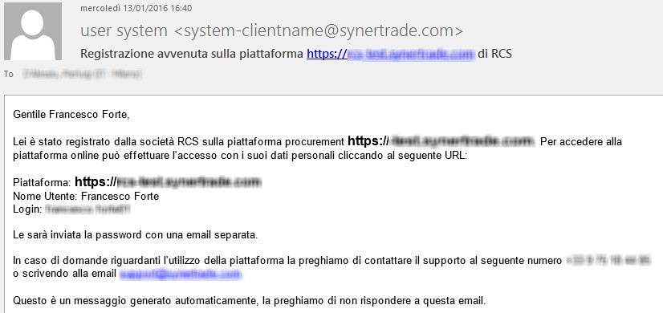
1. Communication of the Platform access credentials
You will receive the login credentials to the Supplier Portal (user and Password) by two separate mails:
1. Example of e-mail containing the assigned User:
Completed registration in the platform
https://fornitori.mediaset.it of Mediaset
Mario Rossi
Dear Mr. Mario Rossi,
Mediaset Company has registered you on the Platform procurement https://fornitori.mediaset.it. The access the Platform online you can insert your personal Data by clicking the following URL:
Platform : https://fornitori.mediaset.it
LINK to Supplier’s Portal
User name: Mr. Mario Rossi Login: mario.rossi
Assigned LOGIN, to be used to access the Supplier’s Portal
A new password will be sent by using aseparated e-mail.
For any question regarding the use of the Platform, please contact our support by calling the following number 800 97 60 23 or writing the e-mail: support.mediaset@synertrade.com.
This is an automatic message, please don’t answer this e-mail.
4

Slide 5
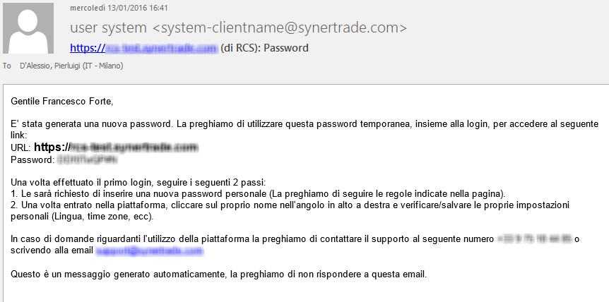
1. Communication of the Platform access credentials
2. Example of e-mail containing the initial password for the assigned user:
https://fornitori.mediaset.it (of Mediaset): Password
Mario Rossi
Dear Mr. Mario Rossi,
A new password has been generated. We kindly invite you to use this temporary password, togheter with the log-in, to access the following link:
URL: https://fornitori.mediaset.it Password: uZZ2»099xx
Once made the first access, please follow these two 2 steps:
You will be asked to enter a new personal password (Please, follow the rules shown in the page).
Once you entered the Platform, click on your name in the high/ right edge and verify/save your own personal Data (Language, time zone, ecc).
For any question regarding the use of the Platform, please contact our support by calling the following number 800 97 60 23 or writing the e-mail: support.mediaset@synertrade.com.
This is an automatic message, please don’t answer this e-mail.
Use this Password to access the Portal for the first time

Slide 6
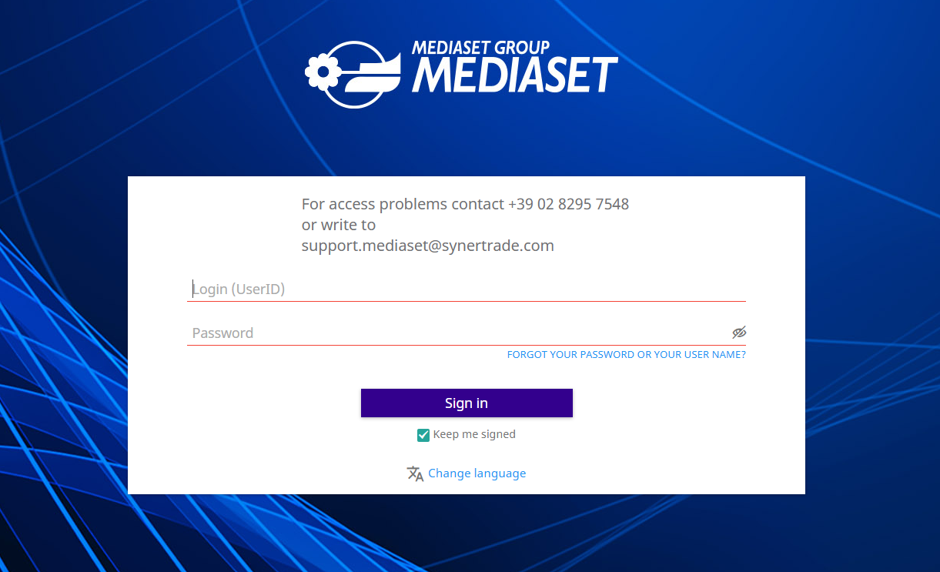
2. First access with the credentials received by e-mail
To access the Mediaset Supplier Portal, use the following link:
https://fornitori.mediaset.it
…the following login page will appear
1. Insert here the LOGIN
2. Insert here the first password
3. Click on «Sign In»

Slide 7
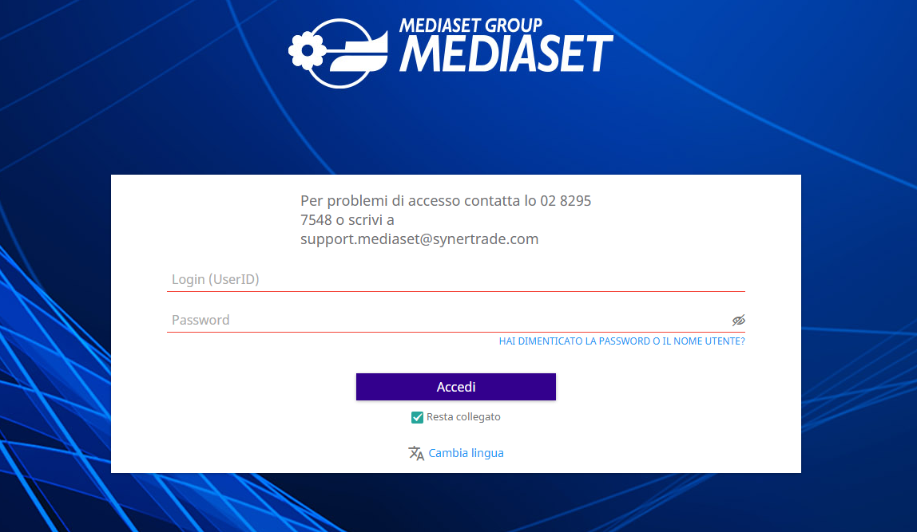
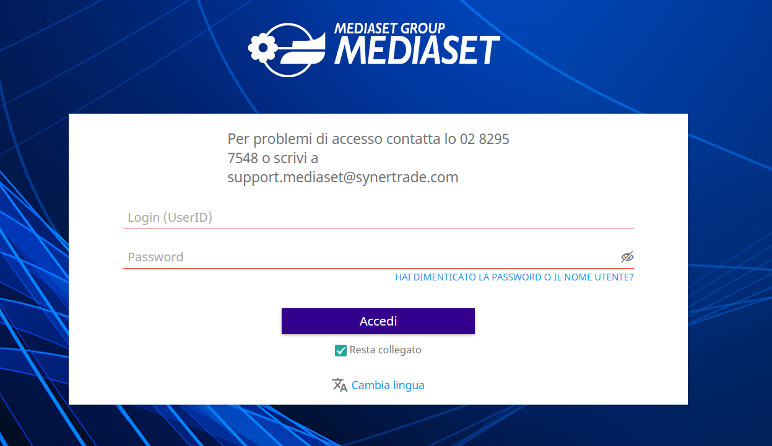
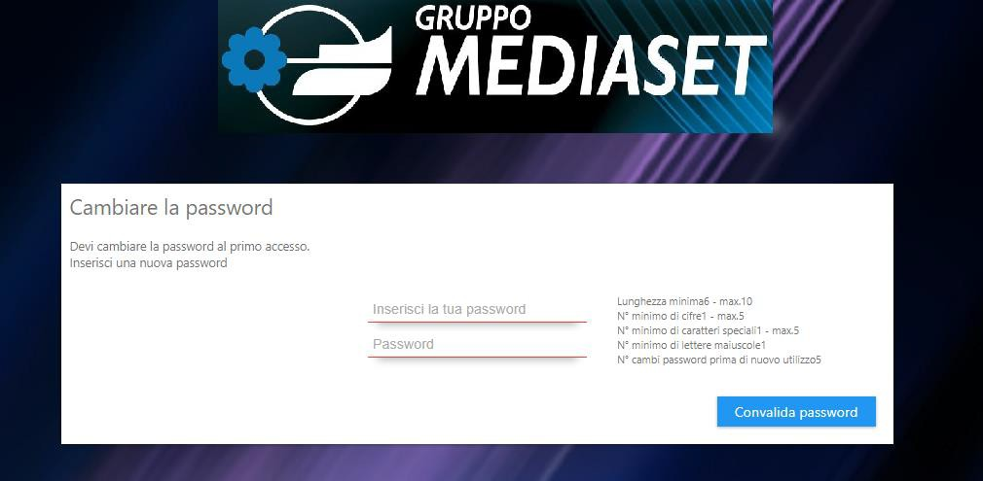
2. First access with the credentials received by e-mail
When you log in for the first time, you need to change your password to access the portal. This password will be the one the supplier will use to keep updated his personal data inside the Synertrade platform.
1. Enter your new password here
Change Password
It is necessary to change the password on the fisrt log in. Insert new password.
Insert the new password
3. Security rules to follow when defining a new password
Validate Password
2 Repeat your new password here

Slide 8
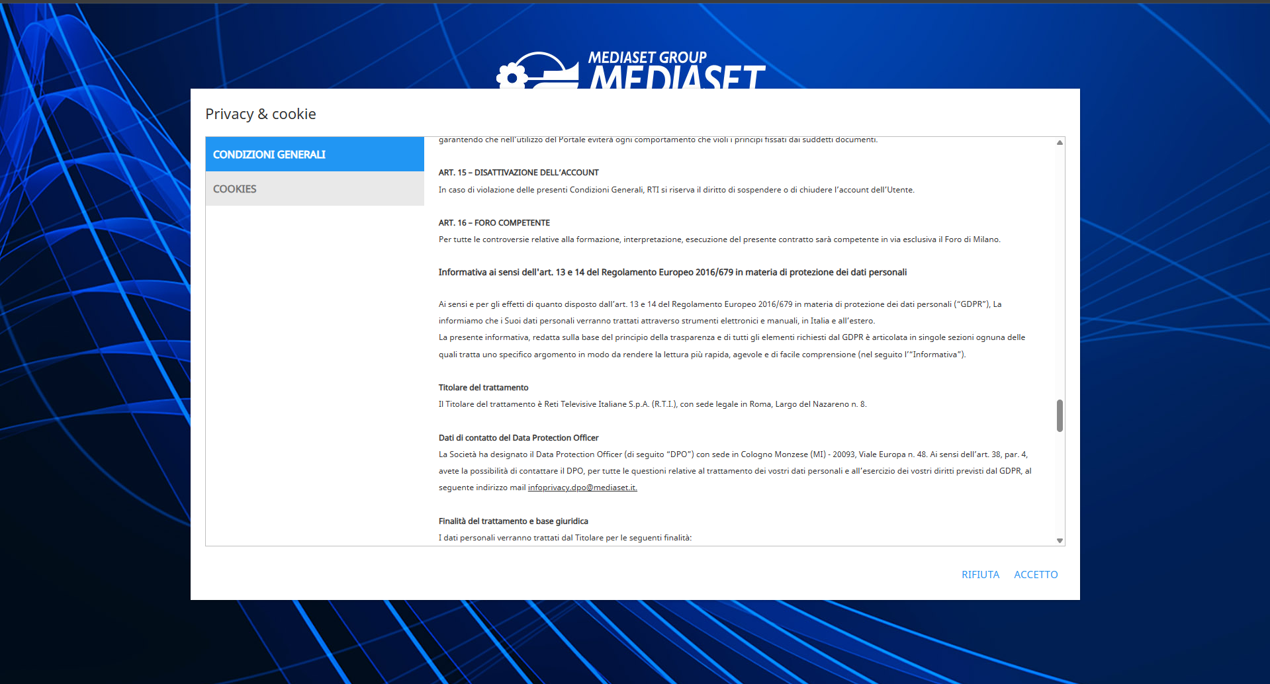
2. First access with the credentials received by e-mail
Upon first access, you must accept the General Conditions for using the platform.
1. Scroll with the mouse to read the General Conditions of Use
2. Click the "Accept" button to access the self-registration process. You will not be able to access the self-registration process if the provider selects "Reject."

Slide 9
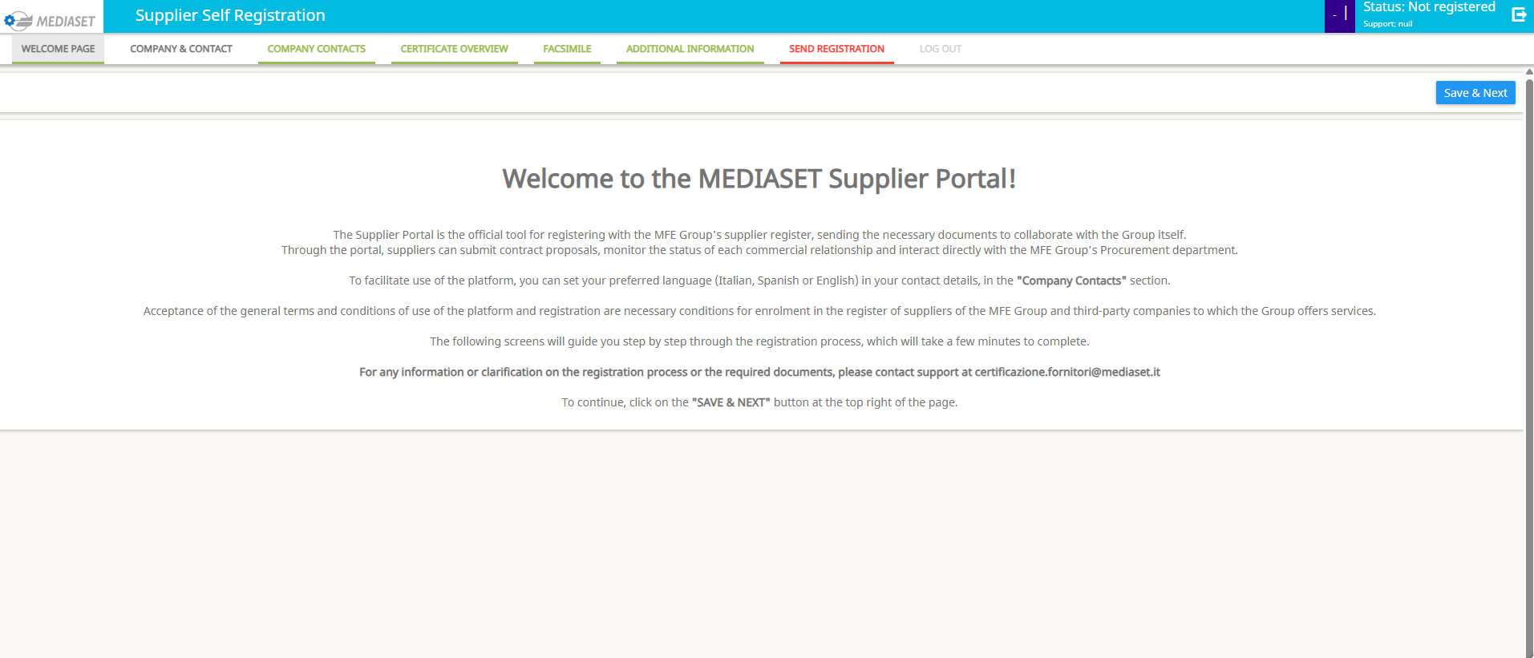
3. Welcome page and Navigation Logic
As shown below, once you log in, the welcome page appears, where you can
view a sequence of tabs containing the set of information to be filled out during the
registration process:
Tab structure
1. Click on "Save & Next" to move to the next tab
The welcome page displays an introduction message to Mediaset's Synertrade platform

Slide 10
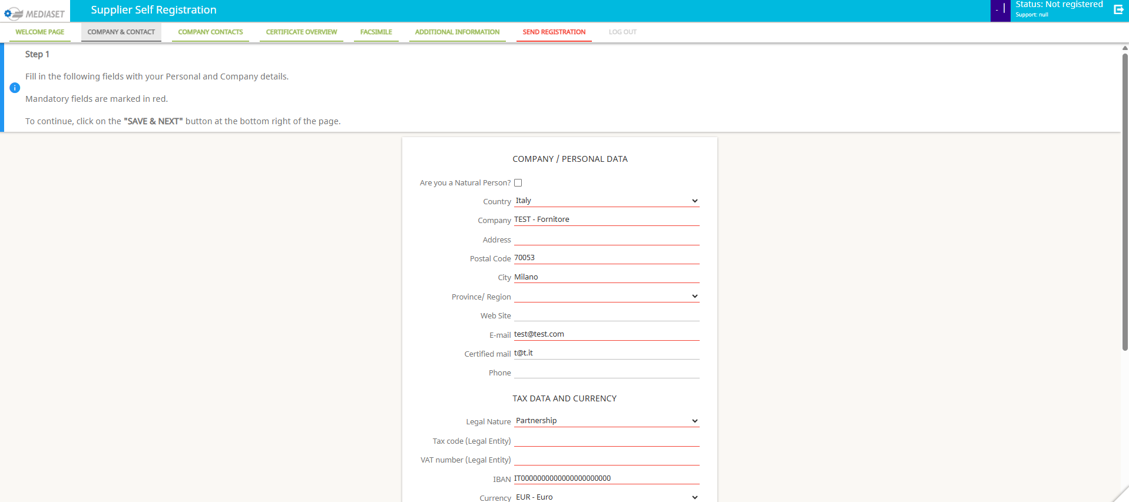
4. Tab Company & Contact (1/4)
In the COMPANY AND CONTACT tab the supplier must enter their basic information, completing any missing information.
1. Check this field if you are a professional with VAT number. The system will automatically update the page proposing dedicated field to be filled in case of appication by a phisycal person
Required fields
Fields marked with this red line must be filled out
2. Select the country your company belongs to or where you reside (in case of physical person)
Depending on the country selected , the system will automatically update the page and the field to be filled
3. Enter here the e-mail address you want to use for receiving any purchase order sent by Mediaset

Slide 11
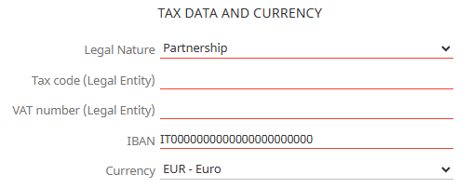
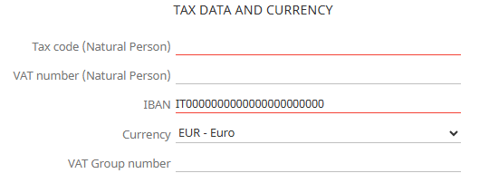
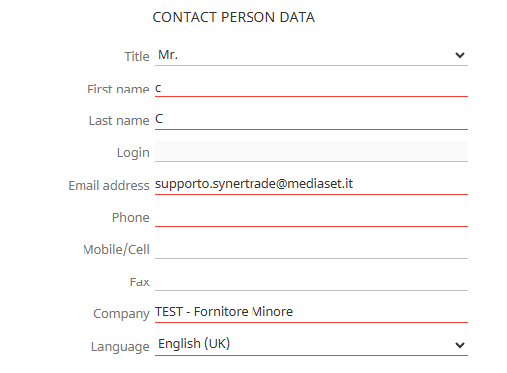
4. Tab Company & Contact (2/4)
SECTION TAX DATA AND CURRENCY
In this section, you are required to provide the company's/individual's tax information. The mandatory nature of the fields varies depending on the nature of the applicant.
Legal Person (Italian Case)
Natural person (Italian Case)
SECTION CONTACT PERSON DATA
To be filled in with your personal/company data, which will be used to generate the system user .
This field cannot be edited by the user
This field is populated by the system upon saving.
1. Enter your work email address (if a professional) or your company email address (if applying for a company)
2. Enter the company name or surname (if a natural person)

Slide 12
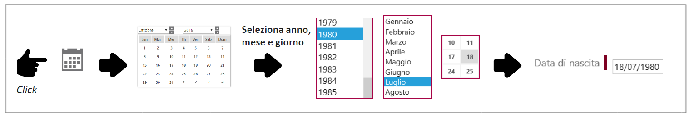
4. Tab Company & Contact (3/4)
Helpful information for completing the form:
At the beginning of each tab there is an indication on how to fill in the data
Filling in date fields:
Select Year, Month, Day
Birth Date

Slide 13
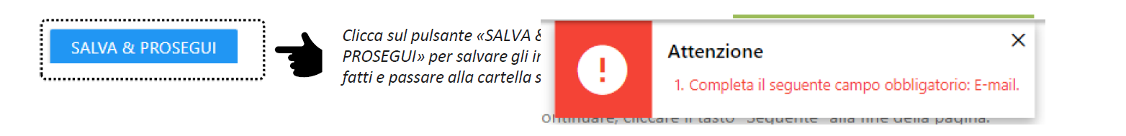

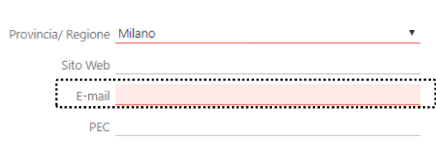
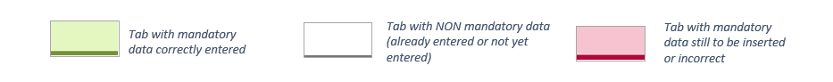
4. Tab Company & Contact (4/4)
Helpful information for completing the form:
1. Saving data and moving to the next tab:
Click on the "SAVE and NEXT" button to save and move to the next tab.
2. Compilation failure / error messages:
A field is missing or incorrectly filled in.
The field is highlighted in
red and a warning icon appears
in the top right.
3. Tab color legend:

Slide 14
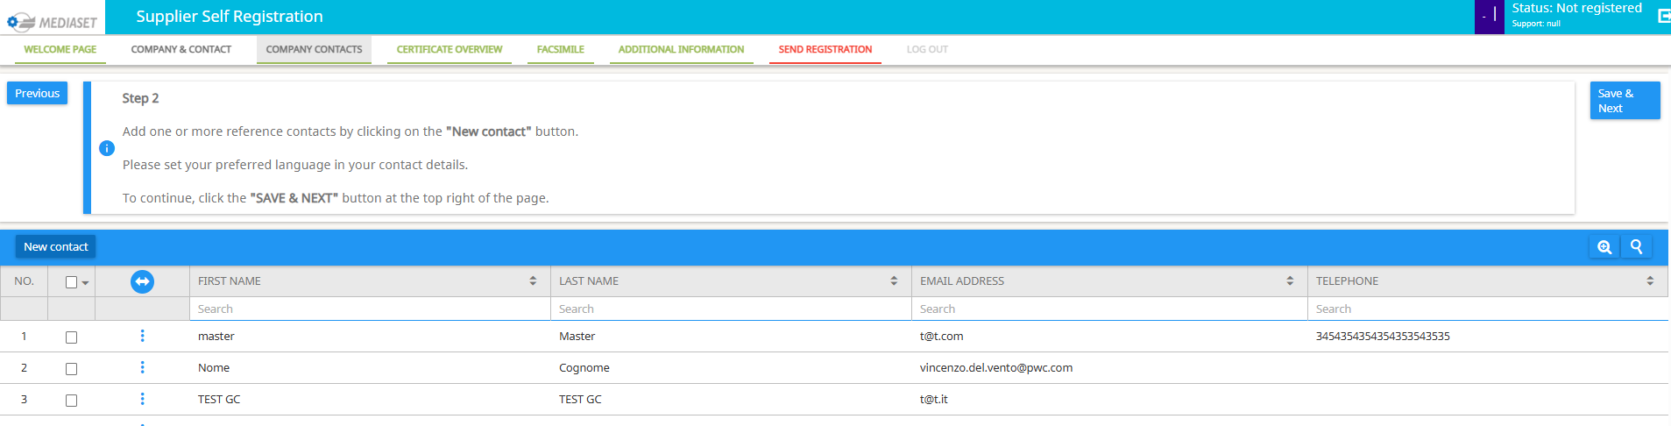
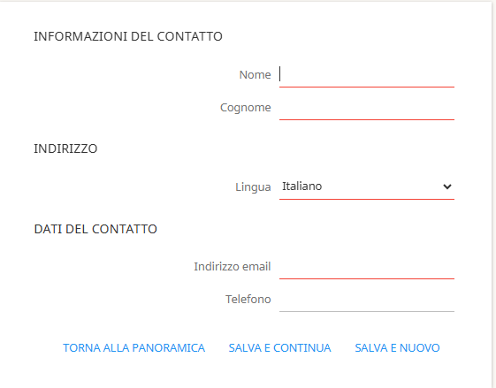
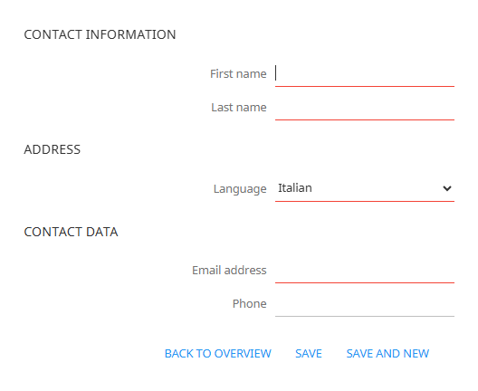
4. Tab Company contacts
Within the SUPPLIER CONTACTS tab, the supplier can add additional contacts in addition to the primary one already
entered in the COMPANY & CONTACT folder.
1. Click on the "NEW CONTACT" button to add an additional user to the system
2. Enter the new user's information and then click "Save" or "Save and New" to sequentially add a new contact.

Slide 15
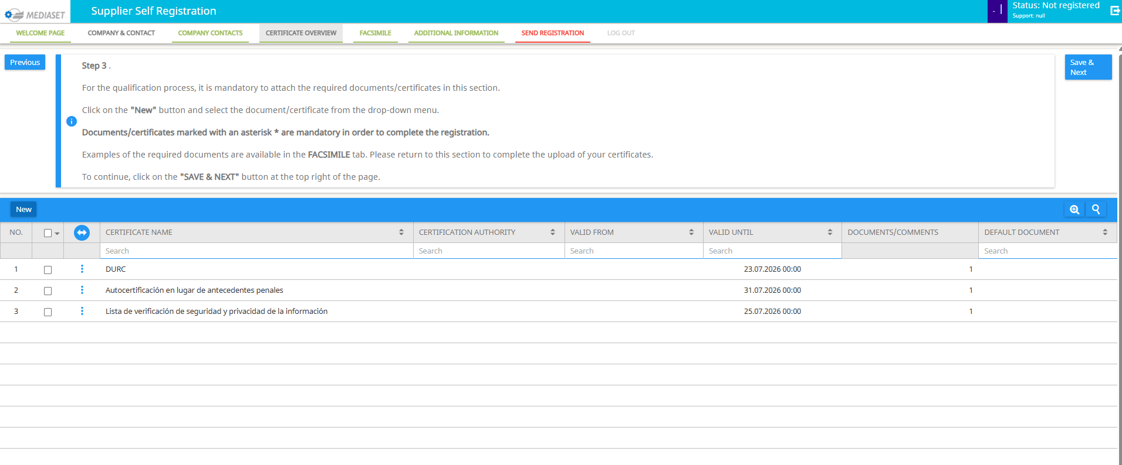
4. Tab Certificate Overview (1/5)
Within the CERTIFICATES OVERVIEW tab, the supplier manages and uploads the certificates/documents required by Mediaset.
Mandatory certificates are preceded by an asterisk (*).
Examples of the required documents are available in the following tab “FACSIMILE" (see slide 23).
1. Click “New” to add a new certificate

Slide 16
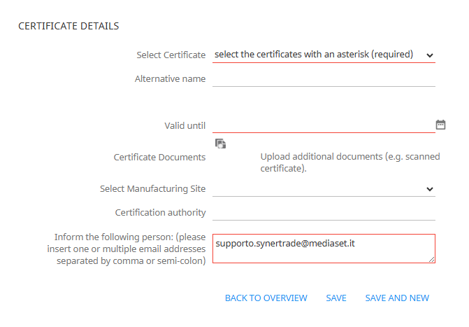
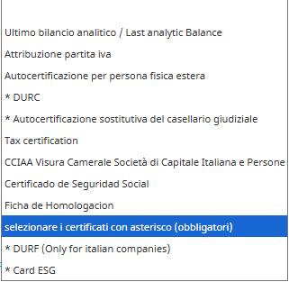
4. Tab Certificate Overview (2/5)
Within the CERTIFICATES OVERVIEW tab, the supplier manages and uploads the certificates/documents required by Mediaset.
Mandatory certificates are preceded by an asterisk (*).
Examples of the required documents are available in the following tab “FACSIMILE" (see slide 23).
1. Move the mouse over the "Select Certificate" field
2. Select the certificate you want to add. (Required certificates are marked with an asterisk.)

Slide 17
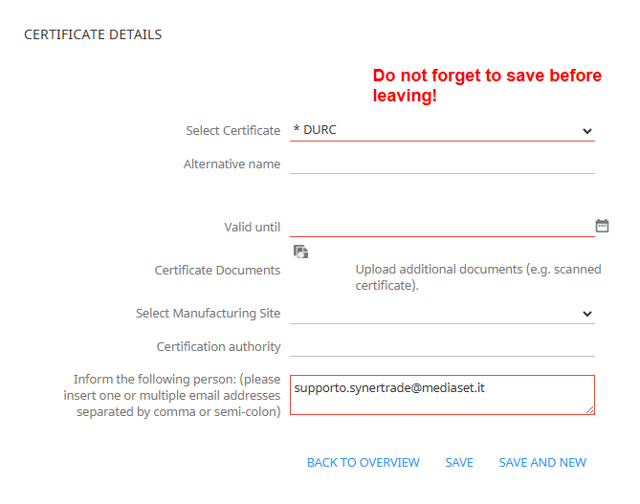
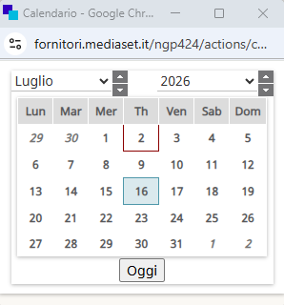
4. Tab Certificate Overview (3/5)
Within the CERTIFICATES OVERVIEW tab, the supplier manages and uploads the certificates/documents required by Mediaset.
Mandatory certificates are preceded by an asterisk (*).
Examples of the required documents are available in the following tab “FACSIMILE" (see slide 23).
1. Click on the icon
2. Enter the certificate expiration date

Slide 18
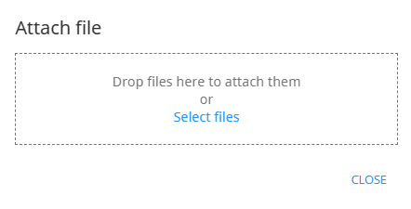
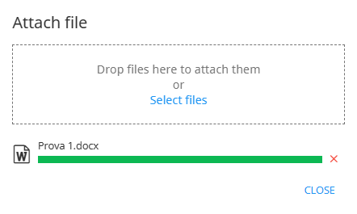
4. Tab Certificate Overview (3/5)
Within the CERTIFICATES OVERVIEW tab, the supplier manages and uploads the certificates/documents required by Mediaset.
Mandatory certificates are preceded by an asterisk (*).
Examples of the required documents are available in the following tab “FACSIMILE" (see slide 23).
2. Click on "Select Files" to search for the document on your computer
It is mandatory to insert a Document in order to save the certificate
1. Click on the icon
3. Once the completion bar has turned green you can click on the "Close" button

Slide 19
4. Tab Certificate Overview (3/5)
Within the CERTIFICATES OVERVIEW tab, the supplier manages and uploads the certificates/documents required by Mediaset.
Mandatory certificates are preceded by an asterisk (*).
Examples of the required documents are available in the following tab “FACSIMILE" (see slide 23).
2. Enter additional non-mandatory fields if necessary
1. Enter the email address of the person to whom you want to send the notification emails here.
By default, the system suggests the primary contact's email address.

Slide 20
4. Tab Certificate Overview (4/5)
Within the CERTIFICATES OVERVIEW tab, the supplier manages and uploads the certificates/documents required by Mediaset.
Mandatory certificates are preceded by an asterisk (*).
Examples of the required documents are available in the following tab “FACSIMILE" (see slide 23).
2. Click “Back to Overview" to return to the certificate overview page.
N.B.
It is important to save the certificate before selecting this button, otherwise the certificate will not be present in the portal.
3. Click "Save and New" to save and directly insert a new certificate into the portal.
1. Click "Save and Continue" to save the entered certificate.

Slide 21
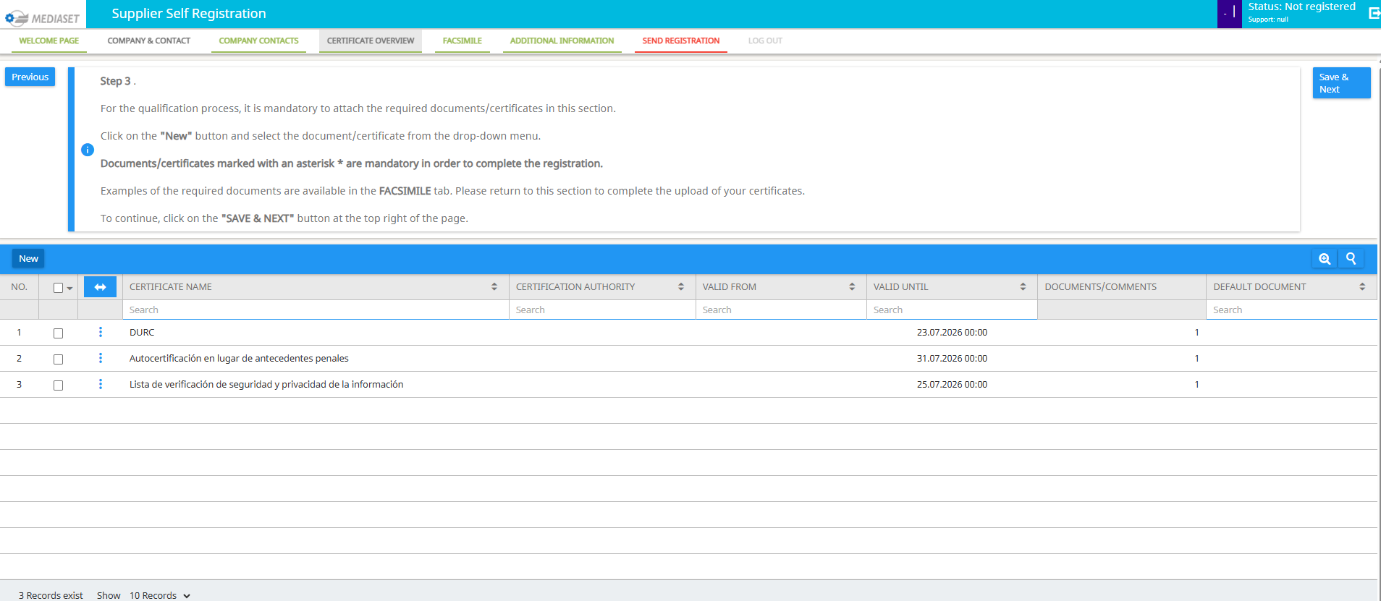

4. Tab Certificate Overview (5/5)
Within the CERTIFICATES OVERVIEW tab, the supplier manages and uploads the certificates/documents required by Mediaset.
Mandatory certificates are preceded by an asterisk (*).
Examples of the required documents are available in the following tab “FACSIMILE" (see slide 23).
1. To see the activities available for each certificate in the portal, click on the 3 dots
2. Click on "Open" to be able to modify the data entered on the selected certificate

Slide 22
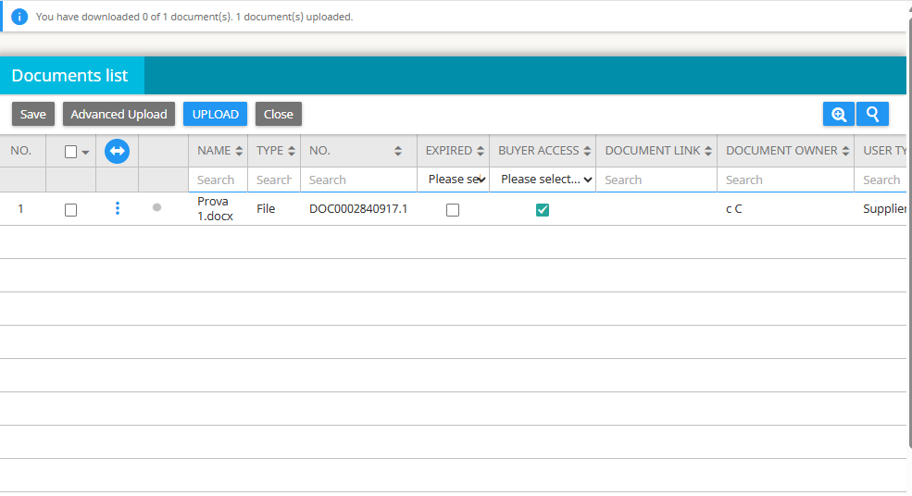
4. Tab Certificate Overview (5/5)
Within the CERTIFICATES OVERVIEW tab, the supplier manages and uploads the certificates/documents required by Mediaset.
Mandatory certificates are preceded by an asterisk (*).
Examples of the required documents are available in the following tab “FACSIMILE" (see slide 23).
4. Click on "Save"
5. Click on "Close"
3. Click the three dots and then click:
Download: to download the uploaded certificate
Upload new version of the document: to upload a new version of the document
Delete: to delete the selected file
1. To see the activities available for each certificate in the portal, click on the 3 dots
2. Click on "Open document in a new browser page" to view the uploaded documents

Slide 23
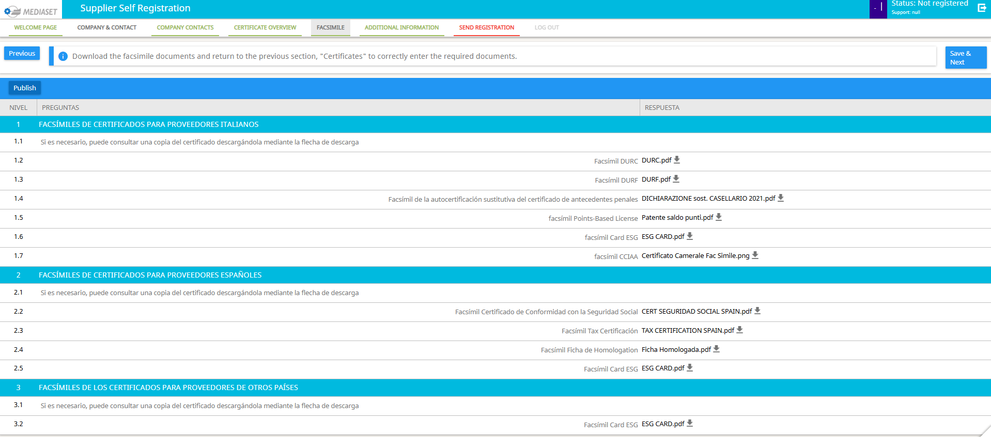
4. Tab FacSimile
Within the FAC-SIMILE tab, you can download all the types of certificates required during OnBoarding. This section allows the user to view a facsimile of the required certificates.
1. Click on the icon of the desired certificate to download the FACSIMILE.

Slide 24
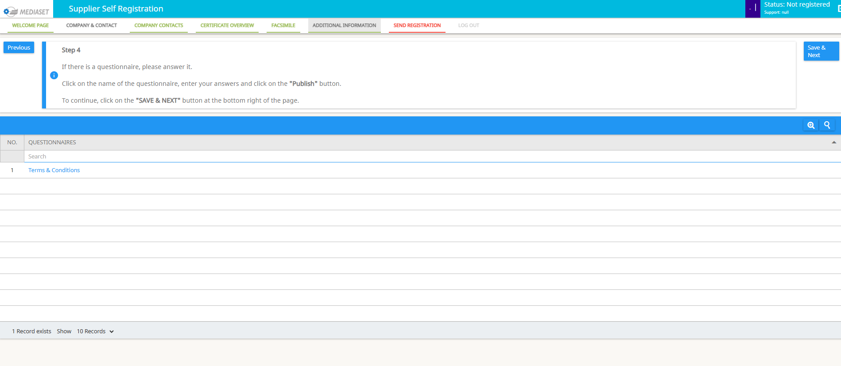
4. Tab Additional Information
The Mediaset Code of Ethics is contained in the Additional Information tab.
1. Click on «Terms & Conditions»

Slide 25
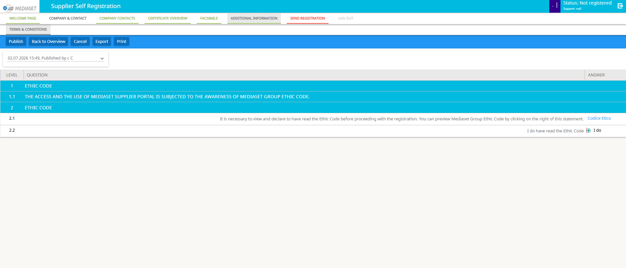
4. Tab Additional Information
The Mediaset Code of Ethics is contained in the Additional Information tab.
3. Click on "Publish" to send confirmation of reading the Code of Ethics
4. Click on “Back to overview" and then on "Save & Next" to proceed.
2. Click on the "I do" button to confirm reading it within the portal
1. Click on the blue link to view the Code of Ethics on a second web page.

Slide 26
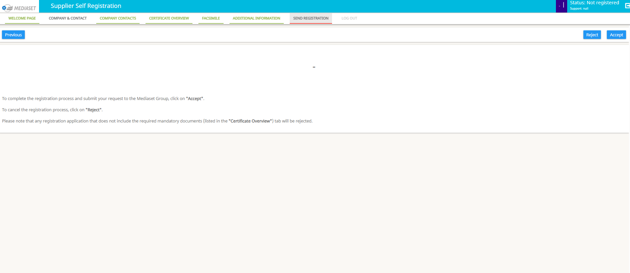
4. Tab Send Registration
In the SEND REGISTRATION tab you can complete the registration and send your application to Mediaset
To complete the registration process and submit your Mediaset Group application, click "Accep."
To cancel the registration process, click "Reject”
Please note that any registration application that does not include the required documents (listed in the "Certificates Overview" tab) will be rejected.

Slide 27
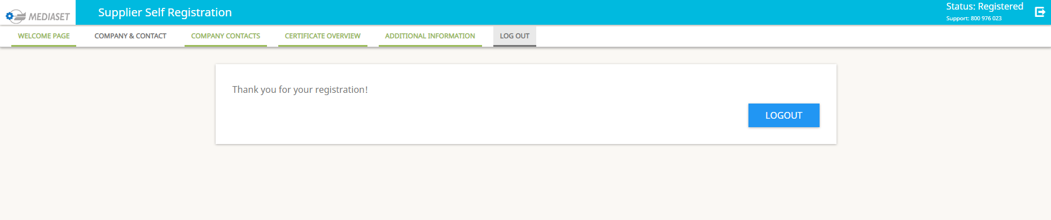
4. Tab Log Out
LOGOUT Tab: After this step, the supplier will be able to access the platform at any time using the login credentials received during registration.
The new REGISTERED status indicates that the request was successfully submitted
Click on the "LOGOUT" button to exit the application

Slide 28
Thank you for your attention

